Slide 1
Economic Security Meets Sustainable Trade: Integrating Economic Security into EU Trade Agreements
Isola Clara Macchia
Ph.D. Researcher

Slide 2
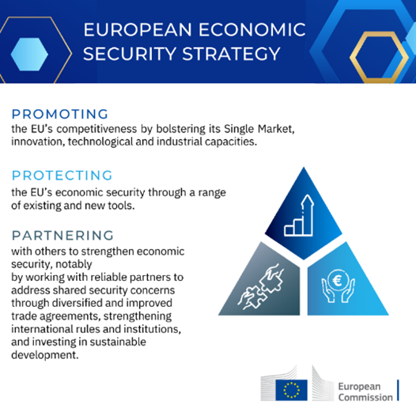
Introduction
2020-2022: big economic shocks
Growing focus on economic security within EU (trade) policy

Slide 3
What future for trade and sustainable development?
Economic security vs sustainable development?
Overview:
Trade policy and sustainable development after Lisbon
EU economic security strategy 2023 and 2024
Small case study: Sustainable Fisheries Partnership Agreements (SFPAs)
Conclusions

Slide 4
Trade policy & SD post-Lisbon
Lisbon Treaty entered into force in 2009
Article 3(3): “the EU shall work for the sustainable development of Europe based on a balanced economic growth […] aiming at full employment and social progress, and a high level of protection and improvement of the quality of the environment”
Article 3(5): “the EU “in its relations with the wider world, […] shall uphold and promote its values and interests” contributing to sustainable development, free and fair trade”
Article 21: “the EU “shall seek to develop relations and build partnerships with third countries, and international, regional or global organisations. […] It shall promote multilateral solutions to common problems”
Free Trade Agreements (FTAs) cornerstone of this approach + their TSD chapters

Slide 5
FTAs and TSD chapters
Pre-Lisbon: some commitments on human rights since the 1990s
First FTA post-Lisbon: 2011 EU-South Korea
ILO ratification
Multilateral environmental standards
Obligations to not fail to effectively enforce environmental and labour standards
Dedicated dispute settlement mechanism → non-binding
Civil society participation (DAGs, Civil Society Forum)
Most recent and advanced: 2023 EU-New Zealand
Expanded commitments (gender equality, indigenous rights, climate change, biodiversity)
Binding dispute settlement for TSD disputes (compliance phase + sanctions)

Slide 6
EU economic security strategy /1
FTAs → modernise old ones and diversify with new ones
Raw Material Partnerships
U.S. and India Trade and Technology Councils
New ‘clean-tech partnerships’
Moving on from FTAs?
François Chimits and others, ‘European Economic Security: Current Practices and Further Development’ (2024) EPRS.

Slide 7
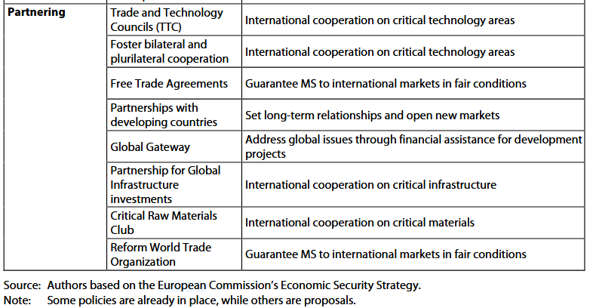
EU economic security strategy /2
Sustainable development tightly linked with economic security goals
Raw materials → criticality for EU supply chains
EU DR and CSDDD → supply chains
François Chimits and others, ‘European Economic Security: Current Practices and Further Development’ (2024) EPRS.

Slide 8
Move to new partnerships
Smaller
Sectoral → focused on economic security priorities
More flexible → not same regulatory convergence as in FTAs
What space for SD commitments? Moving on from TSD chapters?

Slide 9
Sustainable Fisheries Partnership Agreements (SFPAs)
Secure access for EU vessels “to fish for surplus stocks in the exclusive economic zone (EEZ) of third countries, they ensure equal rules, scientific management and social empowerment, with a focus on environmental sustainability, local growth, human rights and shared accountability. […] At the same time, a clause concerning respect for human rights has been included in all protocols to fisheries agreements”
Two types: tuna and mixed (different fish stocks)
Way shorter than FTAs
https://oceans-and-fisheries.ec.europa.eu/fisheries/international-agreements/sustainable-fisheries-partnership-agreements-sfpas_en

Slide 10
Madagascar (tuna) Greenland (mixed)
SFPA | Preamble | Principles | Cooperation and dialogue | Joint organisations | Suspension
Greenland | «determined to cooperate […] in securing sustainable fisheries […] and sustainable exploitation of marine living resources» | «implement in accordance with ECHR and UN Declaration on the Rights of Indigenous People» «employment of seamen in line with ILO Declaration of Fundamental Rights at Work» | Exchange of information Scientific and technical cooperation | Joint Committee in charge of application, implementation, and dispute settlement | Breach of ECHR and UNDRIP commitments
Madagascar | «resolved to pursue closer and more equitable economic and social cooperation [for…] sustainable fisheries» | «employment of seamen under ILO rules and International Maritime Organisation» | Ibid. Economic and social cooperation to encourage capacity-building in Madagascar for sustainable fishing | Ibid. | Breach of human rights

Slide 11
Key differences with FTAs and TSD chapters
Pros | Cons
More sectoral focus on sustainable development (SD capacity building in Madagascar fishing sector) Suspension clause for HR | Dispute settlement procedures less developed in SFPAs than TSD chapter Less institutional architecture (no TSD committee, no DAGs, no Civil Society Forum) No suspension clause for SD (broader than HR)

Slide 12
Conclusion
Potential contestation from CSOs
Chance to define EU economic security more oriented towards sustainable development?

Slide 13
Thank you for your attention!
Feedbacks and questions are highly welcome:
isolaclara.macchia@eui.eu

